Slide 1
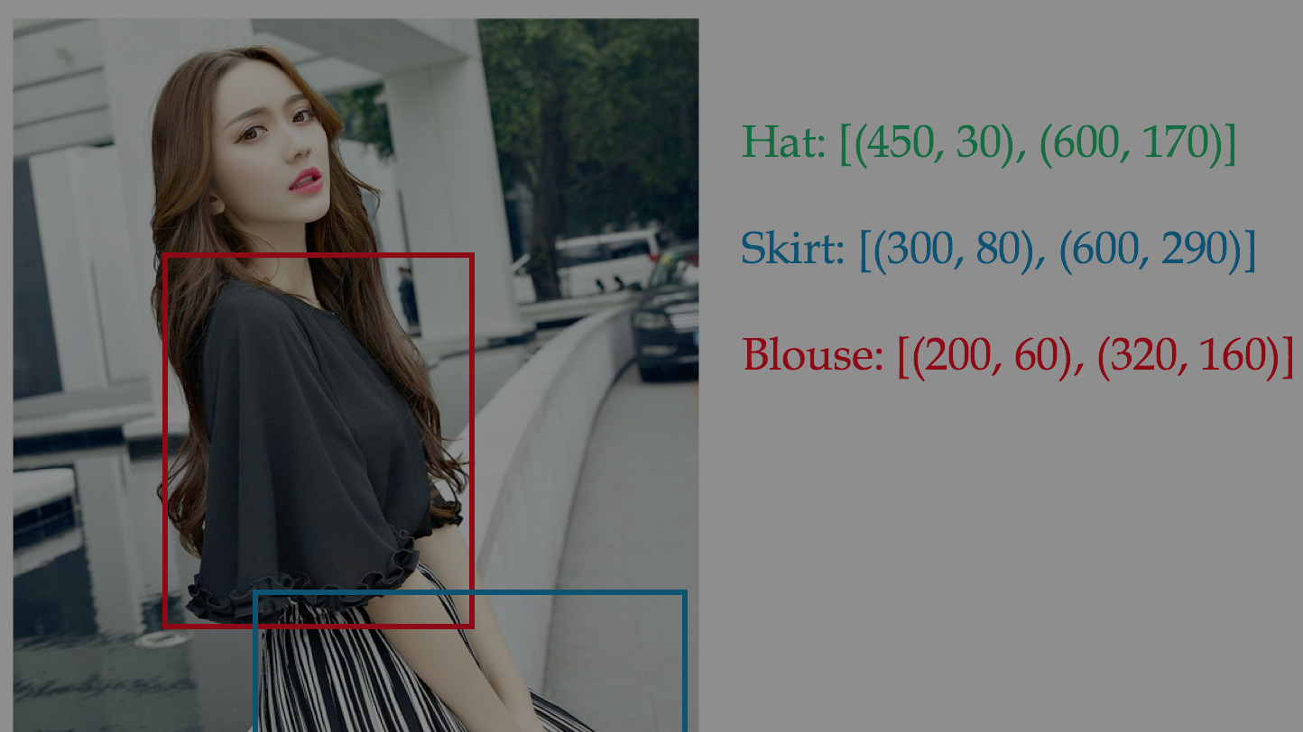
Fashion Detection
Liu Ming
ming987020311@gmail.com

Slide 2
Outline
Data Set
Method
Results
Obstacles

Slide 3
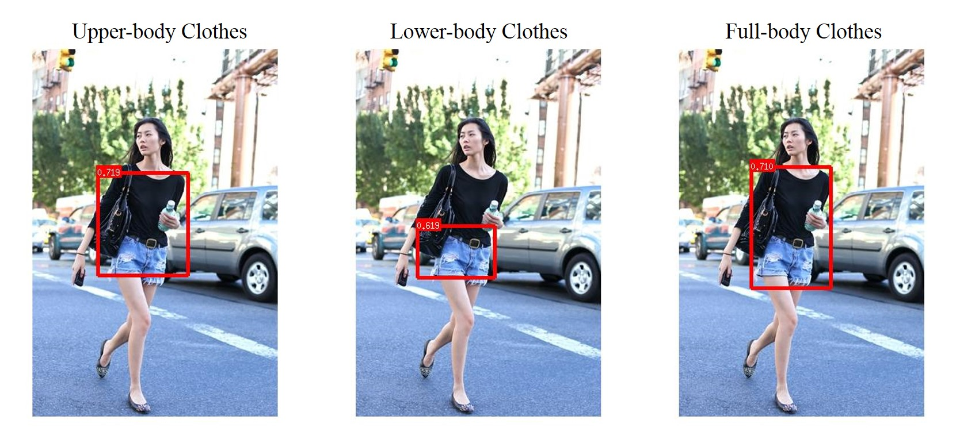
Before I get started
Search on the Internet and found some similar work
But none of them can be directly reused.
Most famous work I have found on Github is shown on right side.
https://github.com/liuziwei7/fashion-detection

Slide 4
Data Set
Given Data Set
Deep Fashion (Sense Time & CUHK)
Best fit
Create for object detection
http://mmlab.ie.cuhk.edu.hk/projects/DeepFashion.html
Color Fashion
Support
Create for image segmentation
https://sites.google.com/site/fashionparsing/dataset

Slide 5
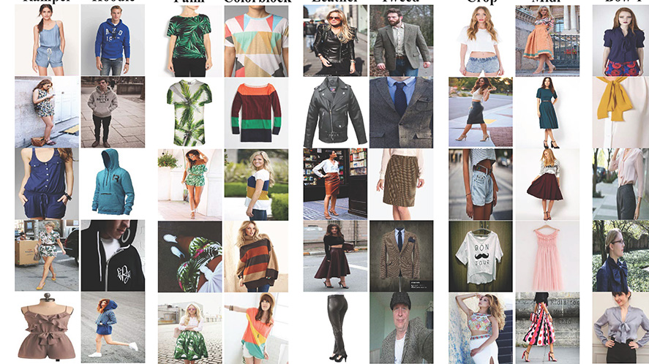
Data Set – Deep Fashion
Provided 200,000+ images with labels of more than 5000+ categories of clothes

Slide 6
Data Set – Deep Fashion
5000+ detailed categories. (crazy…)
Remove adjective and group them into big categories. (38 categories)
Remove categories which has images less than 1000. (22 categories)
Carefully select by common sense and do further grouping by looking at the dataset. (13 categories)
Because there is only one label in each image, this may cause problem
Select about 500 images which only contains target label for each category.

Slide 7

Data Set – Category
Hat
Scarf
Vest & blouse & T-shirt
Dress
Bag
Skirt & shorts & pants
13 categories in total
Socking
Shoes & Boots

Slide 8
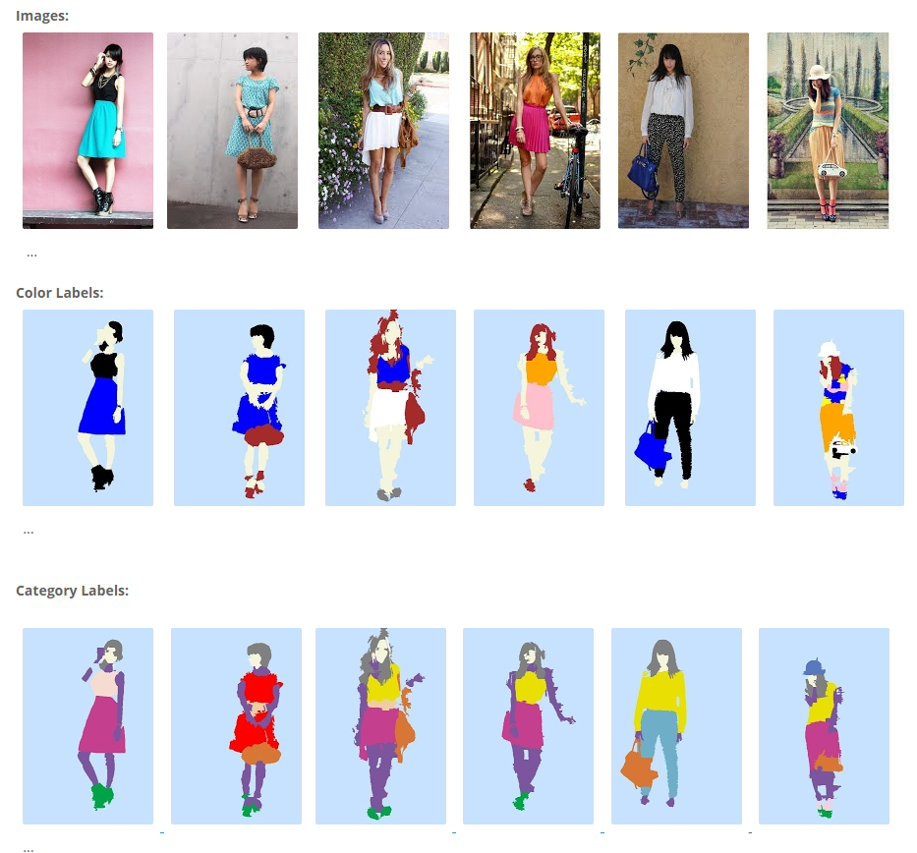
Data Set – Color Fashion
About 3000 images of models

Slide 9
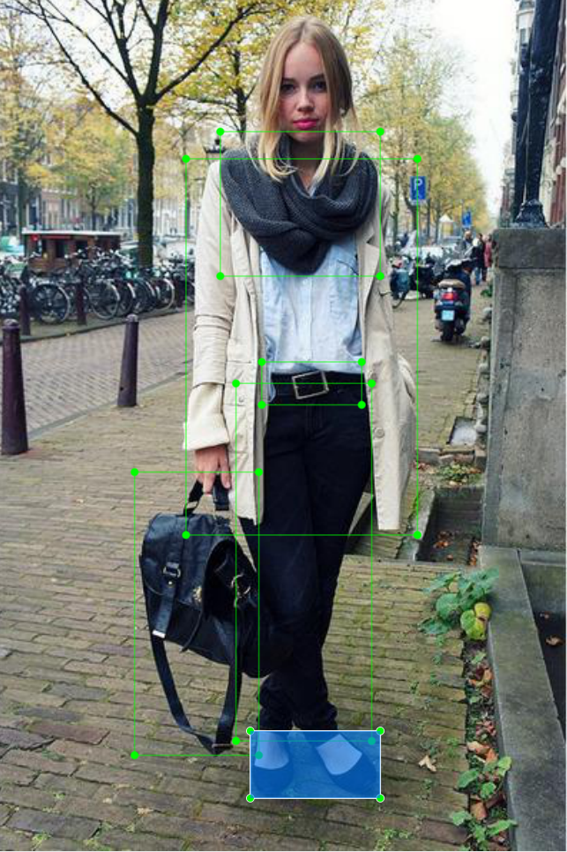
Data Set – Color Fashion
Label every image with LabelMe
Every image will generate a xml file correspondingly.
Images in this dataset is more complicated than Deep Fashion.

Slide 10
Data Set – Over ALL
After doing all these cleaning and labeling, we have 8000 images in total.
6000 comes from Deep Fashion.
2000 comes from Color Fashion
Randomly separate them into
Training data : about 6500 images
Validation data : about 1500 images

Slide 11
Method – How to detect
supervised learning
Given X (images), Y (corresponding category and bounding box)
Sliding windows
YOLO
SSD
Faster RCNN

Slide 12
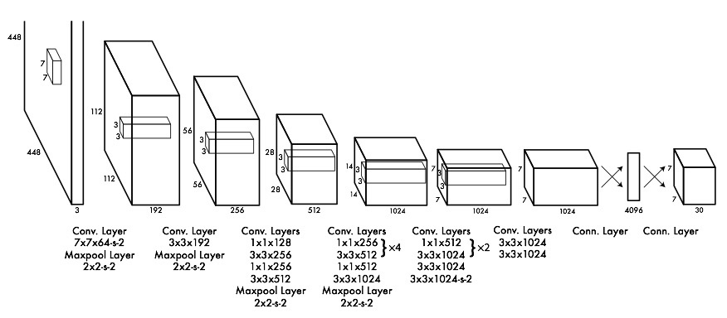
Method – How does YOLO detect
Yolo

Slide 13
Method – Train a YOLO
DarkNet
Original YOLO, implemented using C++
DarkFlow
https://github.com/thtrieu/darkflow
Just prepare your training data and annotation
Change configuration file
Label name
Total class number
Last layer output filter

Slide 14
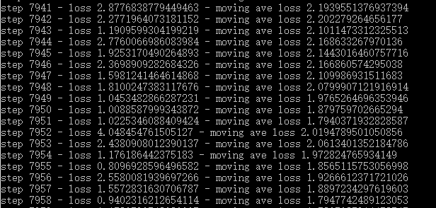
Method – Train a YOLO
Learning rate: 1e-5
Batch: 4 (only 3.35G free memory)
Initialize from COCO
Input size: 416*416
Optimizer: Adam & SGD

Slide 15
Results – Detection Demo
Picture Demo
Camera Demo

Slide 16
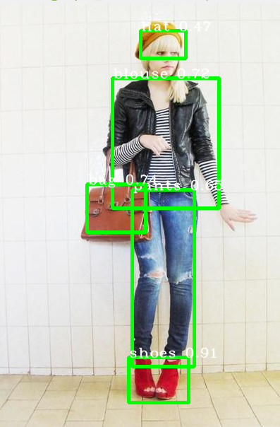
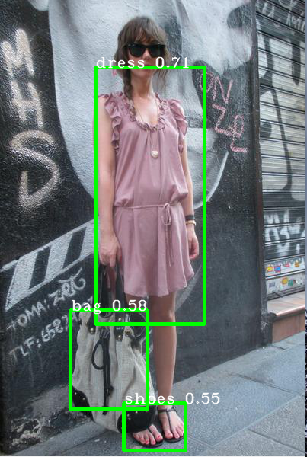
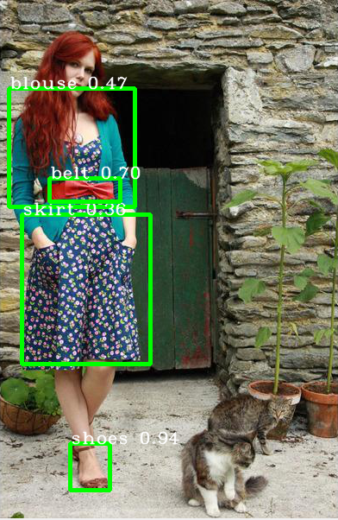
Results – Successful Detection

Slide 17
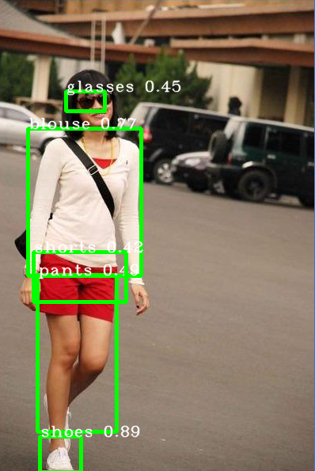
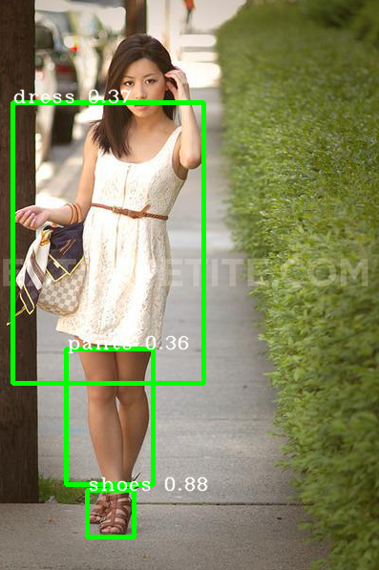
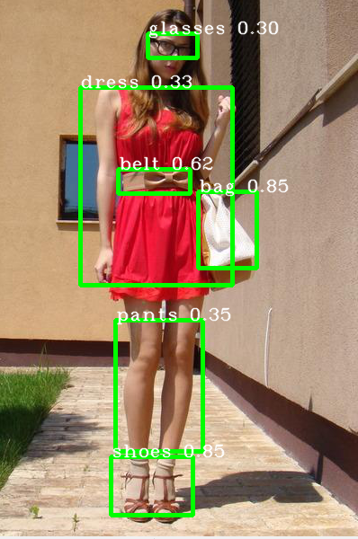
Results – Failed Detection

Slide 18
Results – Evaluation
threshold | accuracy | recall | precision | f1
0.001 | 0.022 | 0.797 | 0.008 | 0.016
0.030 | 0.477 | 0.770 | 0.188 | 0.303
0.100 | 0.582 | 0.734 | 0.348 | 0.472
0.200 | 0.599 | 0.683 | 0.451 | 0.543
0.300 | 0.570 | 0.617 | 0.530 | 0.570
0.500 | 0.405 | 0.627 | 0.419 | 0.502
0.700 | 0.163 | 0.164 | 0.779 | 0.271

Slide 19
Results – Evaluation (speed)
GPU: GTX 960M
YOLO: About 100ms / image.
Experience
Same yolo may get 30ms / image on GTX 1070
Faster rcnn (backbone: res50) may get 700ms / image on GTX 600M
Faster rcnn (backbone: res50) may get 150ms / image on GTX 1070

Slide 20
Obstacle and how to deal with it
1. not providing labelled dataset
2. too much categories
3. overlapping and occlusion
4. most of training item are too large
5. different platforms, frameworks and implementations
6. evaluate bias and variance
7. dealing with detection results

Slide 21
Too much categories (not only existing in my case)
Clothes are different to classify. Some times even human are also hard to tell some clothes are belongs to which type. And It may depends on the objectives of each project.
In my case, I just make some assumptions and do it simply.
Just hope larger dataset and high-quality labeling and magical deep learning can help it perform better.

Slide 22
Overlapping and Occlusion (not only existing in my case)
It depends on the purpose of detection
If we doing clothes detection for safety purpose, such as recognizing the bad guy from CCTV, the 30% of clothes may also be very important of providing evidence.
However, if we are doing the recommender system of showing that item, 30% remaining part may be not important at all. And we do not need to put that 30% remain seeable item into our database.
The result may become better when the number of data grows

Slide 23
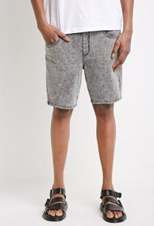
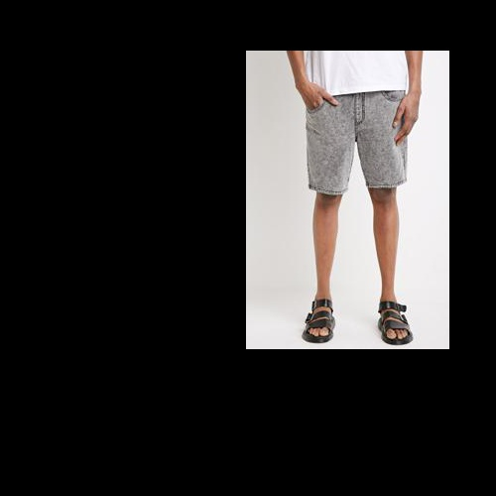
Most of training item are too large
Only existing in Deep Fashion dataset.
May cause YOLO only recognize large items.
Data augmentation

Slide 24
Different platforms, frameworks and implementations (only existing in my case)
This time I used yolo (which is implemented using TF)
Framework wise: Caffe (C++), Darknet (C++), Torch
Platform wise: hard to compile C++ project on windows
Some functions of this DarkFlow yolo are not well implemented
Show accuracy during training
Adding performance on validation set during training

Slide 25
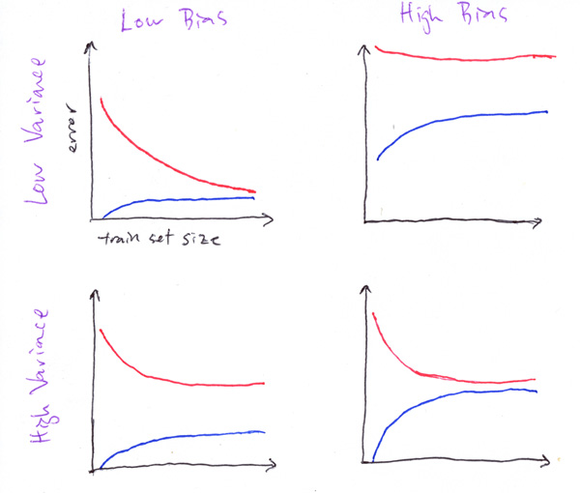
Evaluate bias and variance (only existing in my case)
From experience, of course overfitting !
Datasets are usually large
ImageNet
1,500,000 images, 1000+ categories
COCO
2,500,000 images, 91 categories
PASCAL VOC
500,000 images, 20 categories
Learning curve

Slide 26
Dealing with detection results (not only existing in my case)
Physically adding rules by hands
Shorts and pants, t-shirt and blouse, boots and shoes etc.
Those pairs (ideally) cannot appear on the same person at the same time.
Non-max suppression
Better algorithm and more correct labeled data might be capable of dealing that

